Slide 1
Capstone Project: Citywide Payroll Data
By: Madelene Cruz

Slide 2
Dataframe
Questions/Inquiries
Top 10 job positions/agencies with the highest base pay ‘Per Annum’
Top 10 job positions/agencies with the highest overtime pay
Top job positions/agencies with the overall highest pay
Any distinguishable trends
Has 5.66M rows
Has 17 Columns
Covered the fiscal years of 2014-2023

Slide 3
Cleaning Up the Data Frame and Subsets
Dataset had 4 pay basis:
Prorated Annual
Per Annum
Per Day
Per Hour
Dataset had 9 years worth of data
2014-2023
Created subsets for the years of 2021, 2022, and 2023
Eliminated unwanted columns like Name, Start Date, Work Location, etc.
Created a new column to display Total Pay Overall which summed Base Salary + Total OT Paid + Total Other Pay
Created subsets for Per Annum base salary, Total OT Paid, Total Pay Overall

Slide 4
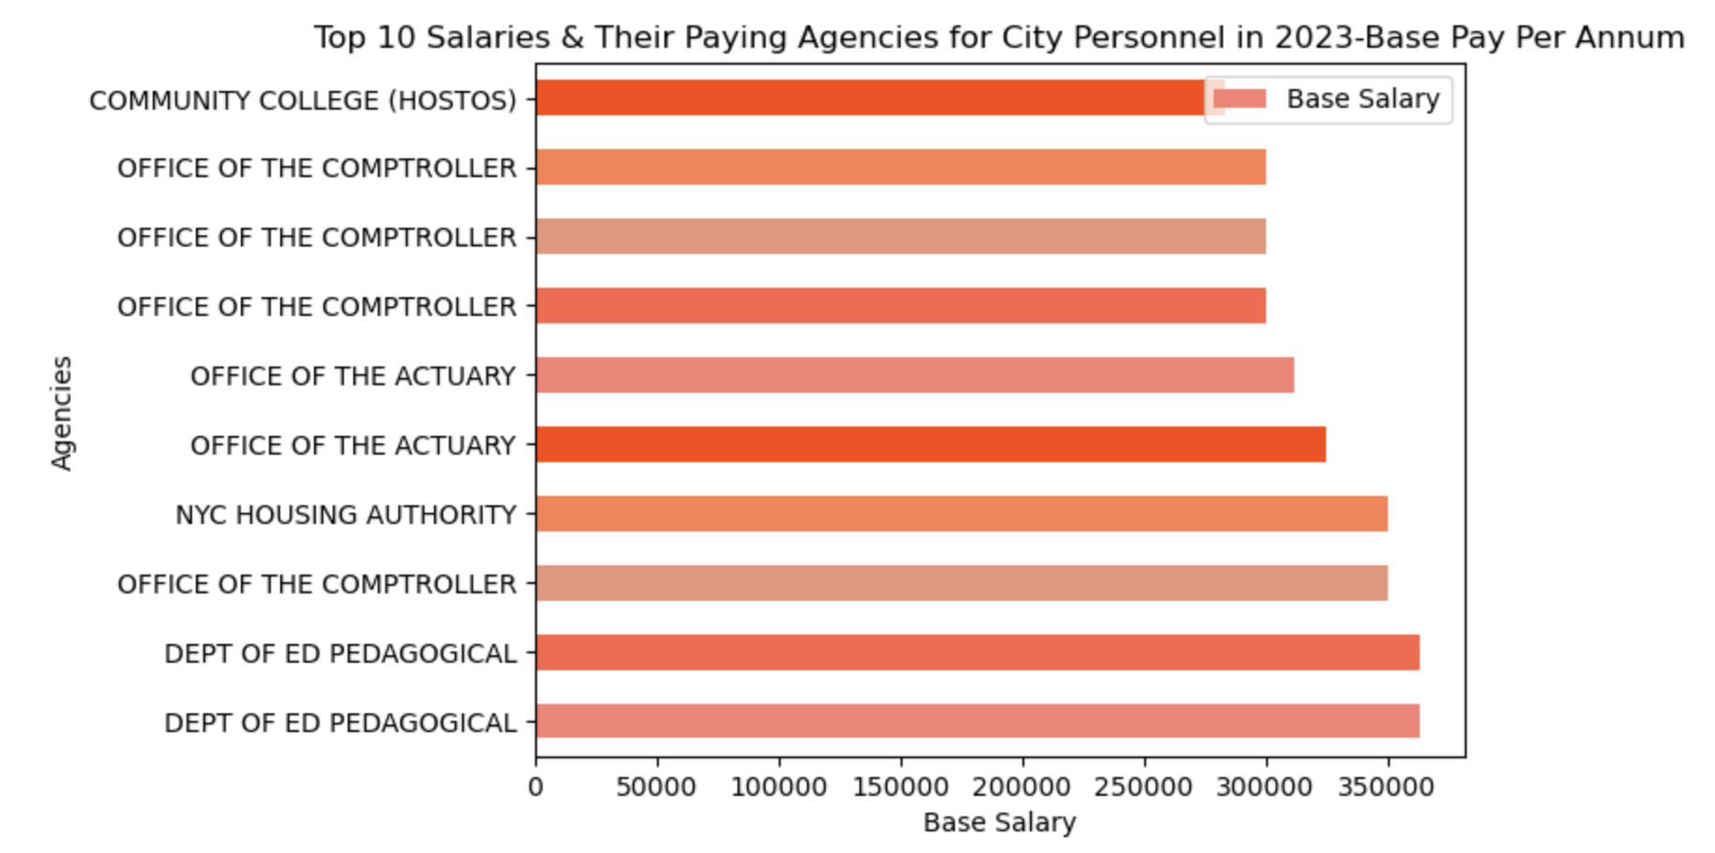
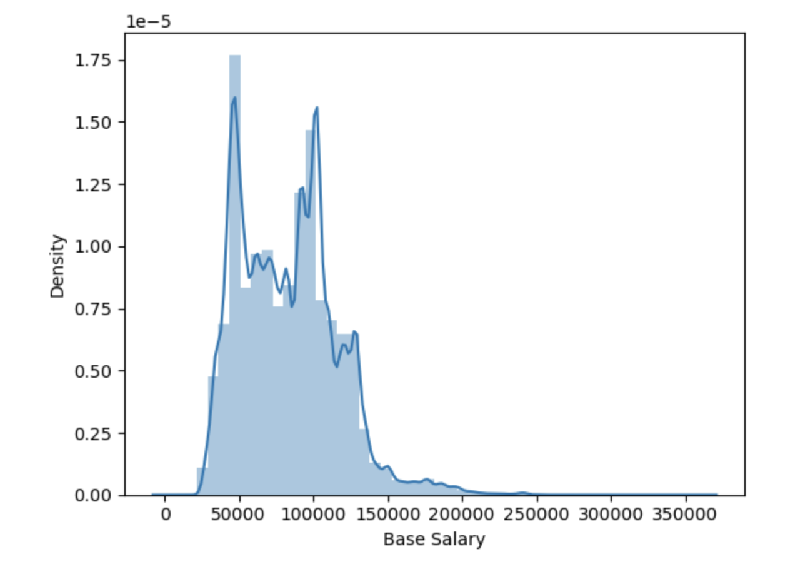
Top 10 Salaries in 2023 Per Annum
V.S
Distplot for all Per Annum Salaries in 2023

Slide 5
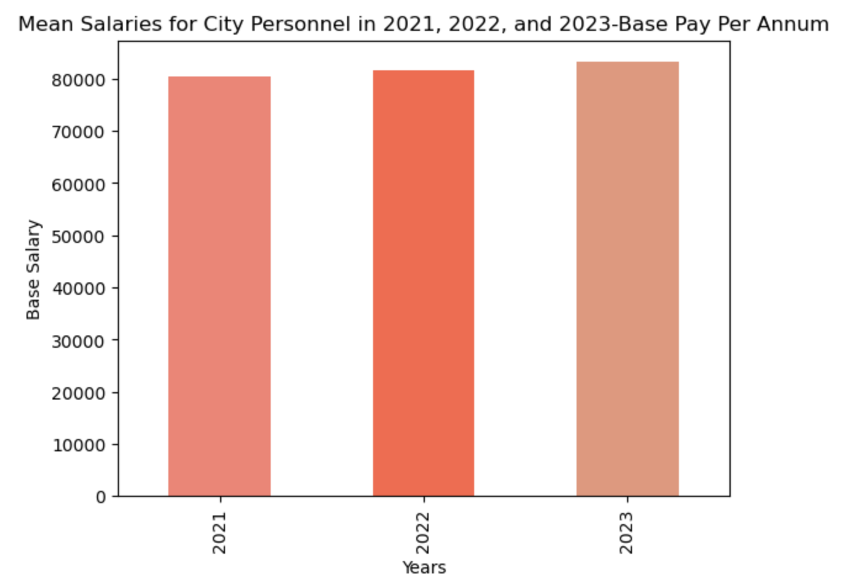
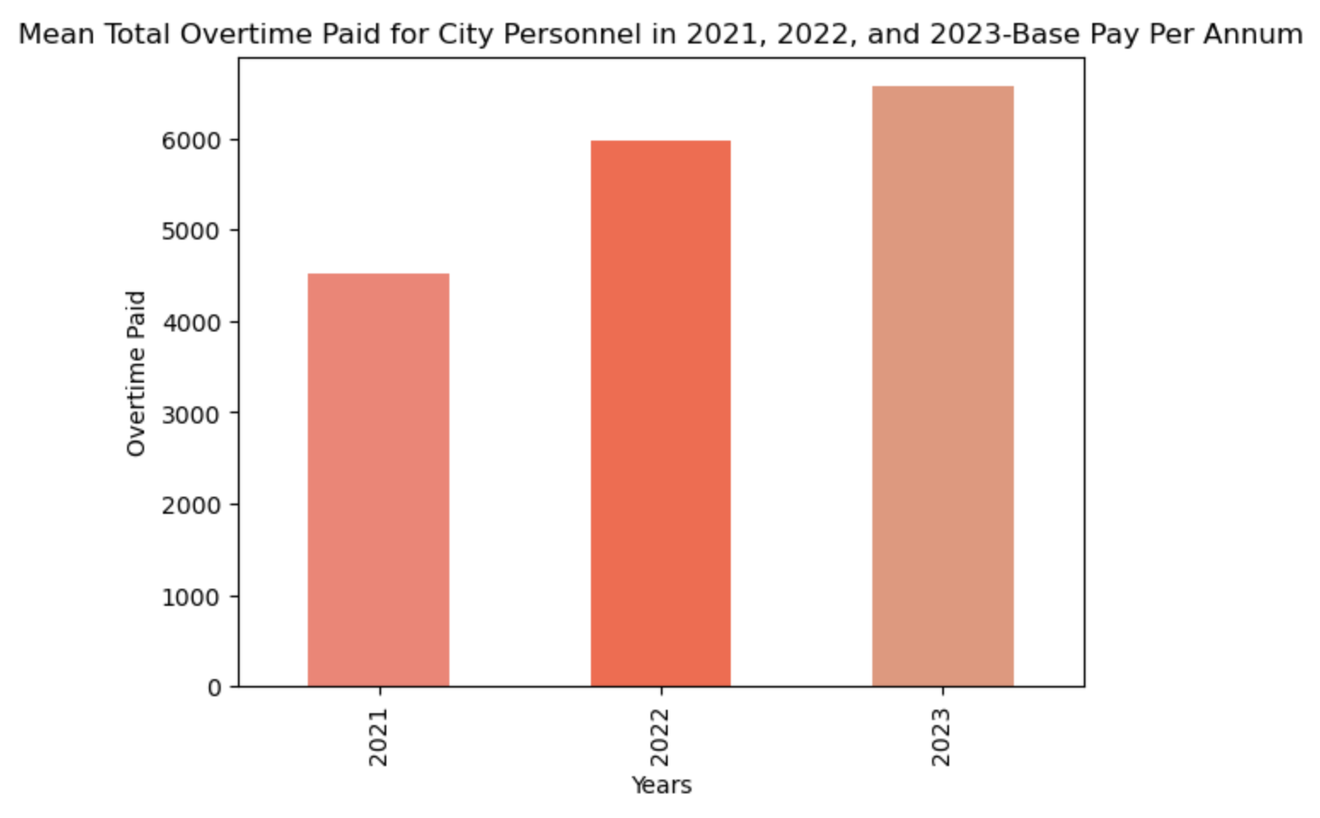
Mean Salaries Per Annum
2021:$80, 323.06
2022:$81, 601.63
2023:$83, 204.65
Mean OT Paid for Per Annum Personnel
2021:$4,519.16
2022:$5,975.25
2023:$6,567.44

Slide 6
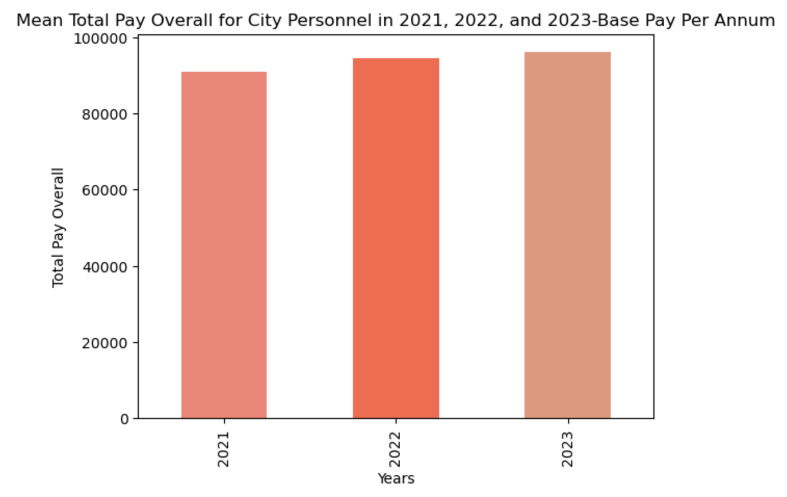
Mean Total Pay for Per Annum Personnel
2021:$90, 780.45
2022:$94, 485.33
2023:$95, 991.12
Take Aways:
Based on the data, the overall mean salary for employees paid per annum has steadily increased from 2021, 2022, and 2023. Overtime payment had a sharp increase between the years of 2021 and 2022 along with the total payment overall for City personnel. It is important to note that within the column Total Other Pay, settlement amounts are included and not distinguished, so this could scew and affect the values seen in Total Pay Overall as some may not be the norm.

Slide 7

References
https://data.cityofnewyork.us/City-Government/Citywide-Payroll-Data-Fiscal-Year-/k397-673e

